Slide 1

Artificial Intelligence
Presented By
Deepak Sharma
Co-Founder and COO
deepak@recogx.ai/ +91 9810323585

Slide 2

Agenda
Introduction to Data Science
Introduction to Artificial Intelligence (AI)
AI Business Application
Limitation of Machine Learning
Why Neural Network
Deep Dive into ANN (Neurons, Layers, Activation Function, Optimisers)
Introduction to Tensor flow & Keras
Deep Learning Architectures
CNN
RNN
LSTM
Concepts of NLP
Applications

Slide 3

Data Science
It is a study to understand the logic behind the behaviour of data
Logic could be pattern, mathematical formula or equation
Bring hidden insight on surface and help to take informed decision

Slide 4










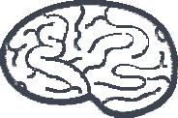



Artificial Intelligence
When machines start thinking like humans and help in taking decision
Machine Learning
Natural Language Processing
Robotics
Deep Learning
Reinforcement Learning
Rule Based

Slide 5

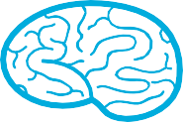





Artificial Intelligence Contd…
MACHINE LEARNING
It deals with system or algorithms to learn
relationships between input and output and identify hidden patterns
DEEP LEARNING
It’s a special branch of
Machine Learning where machine learns relationships between input and output using process used by human brain
NATURAL LANGUAGE PROCESSING
It’s a branch that deals with understanding the human language
REINFORCEMENT LEARNING
For a speciﬁc situation what best possible path or behaviour a program will take get result
ROBOTICS
Transformers movie – when machines behave like human beings
RULE BASED
“If this than this” approach

Slide 6

Impact of AI on Business
Personalized Experience
Fast Customer Acquisition
Automate Routine Process
Faster Business Decisions
Human Error minimized
Predict customer preference
Increase productivity & operational eﬃciencies
Cost Savings
Increase Revenue

Slide 7

Applications of AI
Automotive −
Automobile guidance systems – Driverless Cars
Military −
Weapon orientation and steering • Target tracking
Object discrimination • Facial recognition • Signal/image identiﬁcation
Electronics −
Code sequence prediction • IC chip layout • Chip failure analysis Machine vision • Voice synthesis
Financial −
Real estate appraisal • Loan advisor • Mortgage screening
Currency value prediction • Document readers • Credit application evaluators

Slide 8

Applications of AI Contd…
Industrial −
Manufacturing process control
Quality inspection systems
Machine maintenance analysis, project bidding, planning, and management.
Telecommunications −
Bots
Image and data compression,
Real-time spoken language translation.
Transportation −
Number plate recognition
Truck Brake system diagnosis,
Vehicle scheduling, routing systems.
Medical −
Lifestyle disorder analysis
Xray image analysis
Patients footfall prediction
Software −
Pattern Recognition in facial recognition,
Optical character recognition, etc.
Speech −
Speech recognition,
Speech classiﬁcation
Text to speech conversion.
Anomaly Detection − Prediction of unusual activity.

Slide 9
Natural Language Processing
Branch of Artificial Intelligence that deals with interaction between human and machine.
NLP Objective
Read
Decipher
Understand
Make Sense
Reply

Slide 10
Relation Between AI, ML, Deep Learning & NLP
Artificial Intelligence
Machine Learning
Deep Learning
NLP

Slide 11
Use Case Of NLP – Around us
Language translation applications such as Google Translate
Grammatical accuracy of texts (Microsoft Word and Grammarly)
Interactive Voice Response
Personal Assistant – OK Google, Siri, Cortana and Alexa

Slide 12

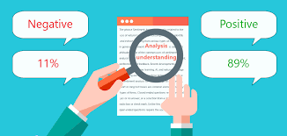

Application in Banking and Finance
Credit Scoring – Access an individual’s creditworthiness by understanding lending risk based on customer digital footprints such as social media account use, internet browsing history, geolocation data.
LenddoEFL, a Singapore based company offers a software called LenddoScore, which use machine learning and Natural Language Processing in accessing creditworthiness of individuals.
Sentiment Analysis – Collecting insights from news, social media, influencers and blogs using NLP and help companies making better business decisions
Sentifi, a Switzerland based company search media news to identify topics that are in discussion on the market and discover events that might impact investment of its customers.
Document Search – Companies can automate and digitise their documentation processing using NLP. They integrate the documents into their existing process workflows and extract most relevant information for quick and credible decision making.
Nuance Communications, a Massachusetts based company, help financial service companies extract and summarise most relevant information from the available historical documentation records and process loan or mortgage based applications.

Slide 13

Application in Banking and Finance
Customer Service – Companies are using chatbot to help customer making payments, fetching transaction and account details and managing finances using NLP.
Kasisto, a New York based company offers a software called KAI, which use machine learning and Natural Language Processing to fulfil services such as product discovery, loan application and customer support.
SAS offers SAS platform that help banks improve customer experience and analyse customer feedback using NLP. It applies Text miner and contextual analysis tool to understand and categorise data to form notification on dashboard and create personalised connections with customer.
Personetics, a London based company offer chatbot service called Assist. The chatbot can integrate with websites, mobile apps, messaging platform. It uses historical customer interaction records to understand customer queries and fulfil request such as change password, setting up appointment with bank etc.

Slide 14


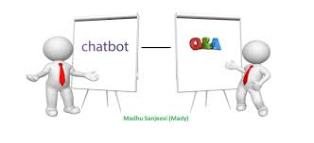
Application in Healthcare
Summarising Narrative Text – NLP system summarise text by identifying key concepts and phrases present in lengthy narrative documents such as clinical notes and academic journals
Data Integrity – NLP system improve clinical data integrity by mapping data elements present in unstructured text to structured field of electronic health record. This enhance the completeness and accuracy of electronic health records
Answering Queries – NLP system process data from multiple source and train itself to learn the answers of queries requested by users. The same system then answer free-text queries and handle multiple sessions simultaneously.

Slide 15


Application in Healthcare
Speech Recognition –NLP enables system to convert or translate voice command into text in different languages using speech to text conversion trained algorithm. This makes document requirement easier by allowing providers to dictate their notes for patients ready for discharge.
Document Parsing – Using optical character recognition we can scan and convert care summaries to text files. NLP is used to parse and analyse the document. This enables point-of-care solution for complex patient problems
IBM setup Watson Health Division in 2014 for growing its expertise in Clinical Decision Support for precision in medicine and cancer care. The system not only analyse EHR but also included social (homeless patients) and behavioural (depressed patients) factors in structured template of clinical note.

Slide 16
Application in Transportation and Logistics
Consumer –UPS launched an AI-enabled customer chatbot that direct its customers to nearest UPS franchises, provide real-time shipping rates and help customers in tracking their packages. Customers can also manage their delivery locations and timings by interacting with chatbot.
Interconnecting Device – Chatbots are relaying the critical information such as electronic appliance breakdown, weather report, new stock availability and road traffic condition to the concerned departments on real-time. This saves a lot of time of the employees and enables quick decision without compromising on efficiency and safety.
Fulfilment Centers –Companies are offering 24x7 visibility for all shipments from ports to warehouse. Users get hourly updates as well as targeted alerts when container reach company fulfilment center.
International Shipments –In case of international shipments the most important concerns are shipment delays, hidden premiums, stranded merchandise and lack of visibility. By applying NLP based AI system such issues are addressed and online freight booking with clear pricing with enforceable contracts are offered.

Slide 17

Tokenization
The process of splitting a paragraph, string or text into words or sentences.
Sentence Tokenization
text = "Hello everyone. Welcome to the NLP session. It's an easy concept to learn“
[“Hello everyone”, “Welcome to the NLP session”, “It's an easy concept to learn”]
Word Tokenization
[“Hello”, “everyone”, “.”, “Welcome”, “to”, “the”, “NLP”, “session”]
Regular Expression
Text = “Let’s study NLP”
[“Let’s”, “study”, “NLP”]

Slide 18
Stemming
Stemming is the process of mapping a group of words to the same stem or root.
For example
Retrieval
Retrieved
Retrives
Stem word : Retrieve
Type of Stemming : Porter’Stemmer, Lovins Stemmer, Dawson Stemmer, Krovetz Stemmer, Xerox Stemmer and N-Gram Stemmer

Slide 19
Stemming – Implementation in Python
from nltk.stem import PorterStemmer
words= ["write", "writing", "writes"]
sample_ps =PorterStemmer()
for x in words:
root_Word=sample_ps.stem(x)
print(root_Word)
Output
write
write
write

Slide 20
Lamenting
Lamenting is the process of mapping a group of words to the same lemma and ensure that lemma belong to language. Lemma is dictionary word or citation word.
He He
was be
running run
and and
eating eat
at at
same same

Slide 21
Lamenting – Implementation in Python
nltk.download('wordnet')
from nltk.stem import WordNetLemmatizer
wordnet_lemmatizer = WordNetLemmatizer()
text = "writes writing study studying"
tokenization = nltk.word_tokenize(text)
for w in tokenization:
print("Lemma for {} is {}".format(w, wordnet_lemmatizer.lemmatize(w)))
Output:
Lemma for writes is writes

Slide 22
Application Of Stemming and Lamenting
Web Search Engine
Text preparation for Sentiment Analysis
Reduce the number of tokens for document clustering
Speed up the document processing

Slide 23
Part of Speech Tagging
The process of marking up a word in a text (corpus) as corresponding to a particular part of speech, based on both its definition and its context (nouns, verbs, adjectives, adverbs, etc)
It is possible for a single word to have a different part of speech tag in different sentences based on different contexts.
For example - They refuse to permit us to obtain the refuse permit.
('They', 'PRP'), ('refuse', 'VBP'), ('to', 'TO'), ('permit', 'VB'), ('us', 'PRP'),('to', 'TO'), ('obtain', 'VB'), ('the', 'DT'), ('refuse', 'NN'), ('permit', 'NN’)
PRP – Personal Pronoun, VBP – Verb, DT – Determiner, NN - Noun

Slide 24
Types of POS tagging
Rule Based POS Taggers (The Brill’s tagger)
If the preceding word is an article, then the word in question must be a noun.
Stochastic Based Taggers (Hidden Markov Model )
Tag sequence probabilities and word frequency measurements.

Slide 25
Text Mining
The process of analysis of texts written in natural language and extract high-quality information from text.
Text Mining includes
Text Clustering
Text Categorization
Document Summarization
Entity Extraction

Slide 26

Text Clustering
Text clustering is the application of cluster analysis to text-based documents
It uses machine learning and natural language processing (NLP) to understand and categorize unstructured, textual data.
Steps followed in Text Clustering
Descriptors are extracted from the text
They are analyzed for the frequency in which they are found in the document compared to other terms.
Clusters of descriptors can be identified and then auto-tagged.
Google’ search engine is the application of text clustering

Slide 27
Business Use Case
Creating a product roadmap
Customer and target audience’s reviews can be analyzed and used to create a roadmap of features and products they’ll love!
Identify recurring support issues
Text clustering will enable us to not only see how frequent (or infrequent) an issue is, but also may help identify the root of the issue with additional tags.
Creating better marketing copy
Spot trends in unstructured data

Slide 28
Text Categorization
Text classification or Text Categorization is the activity of labeling natural language texts with relevant categories from a predefined set.
Classification of books in libraries and segmentation of articles in news are essentially examples of text classification.
Use Case
Automate CRM
Search Engine Optimization
Target Marketing

Slide 29
Text Summarization
Text summarization is creating a short, accurate, and fluent summary of a longer text document.
Two main approaches to summarizing text documents
Extractive Methods
Ranking the relevance of phrases in order to choose only those most relevant to the meaning of the source
Abstractive Methods
Generating entirely new phrases and sentences to capture the meaning of the source document.

Slide 30
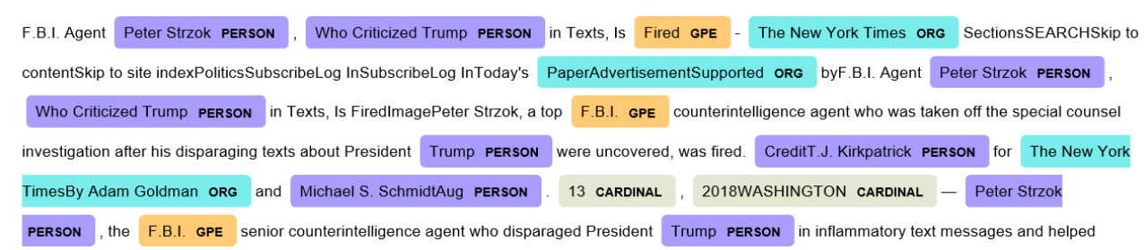
Named Entity Recognition
Locate and classify named entities in text into pre-defined categories such as the names of persons, organizations, locations etc.
Help in answer questions such as:
Which companies were mentioned in document/article
List of products mentioned in complain or reviews
Name and Location of the person in message/tweet

Slide 31
Business Use Case
Audit a call made by an agent to the customer
Classify content
Efficient Search Process
Content Recommendation (Extracting Named Entity and match similarity)
Categorise customer complain and assign to relevant department

Slide 32

spaCy – Advance NLP Library
Free open source library
Useful for Advance NLP
Capable of processing large volume of text
Extract information from text
Use for text preparation for deep learning
Designed for use on production environment

Slide 33
Tokenization | Segmenting text into words, punctuations marks etc.
Part-of-speech (POS) Tagging | Assigning word types to tokens, like verb or noun.
Dependency Parsing | Assigning syntactic dependency labels, describing the relations between individual tokens, like subject or object.
Lemmatization | Assigning the base forms of words. For example, the lemma of “was” is “be”, and the lemma of “rats” is “rat”.
Sentence Boundary Detection (SBD) | Finding and segmenting individual sentences.
Named Entity Recognition (NER) | Labelling named “real-world” objects, like persons, companies or locations.
Similarity | Comparing words, text spans and documents and how similar they are to each other.
Text Classification | Assigning categories or labels to a whole document, or parts of a document.
Rule-based Matching | Finding sequences of tokens based on their texts and linguistic annotations, similar to regular expressions.
Training | Updating and improving a statistical model’s predictions.
Serialization | Saving objects to files or byte strings.
Features of spaCy

Slide 34
Use Cases of NLP + Deep Learning
Text Classification
Spam filtering, classifying email text as spam or not.
Language identification, classifying the language of the source text.
Genre classification, classifying the genre of a fictional story.
Language Modeling
Generating new article headlines.
Generating new sentences, paragraphs, or documents.
Generating suggested continuation of a sentence.
Speech Recognition
Transcribing a speech.
Creating text captions for a movie or TV show.
Issuing commands to the mobile while driving.

Slide 35
Use Cases of NLP + Deep Learning
Caption Generation
Describing the contents of a scene.
Creating a caption for a photograph.
Describing a video
Machine Translation
Translating a text document from French to English.
Translating Spanish audio to German text.
Translating English text to German audio.
Document Summarization
Creating a heading for a document.
Creating an abstract of a document.
Question Answering
Answering questions about Wikipedia articles.
Answering questions about news articles.
Answering questions about medical records.

Slide 36
Bag Of Words
In BOW, we extract features from the text and such features are used in ML model
Helps in preparing the data for Machine Learning model
Simple in understanding and implementation

Slide 37
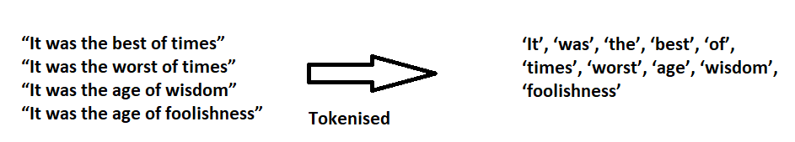
Bag Of Words - Approach
Step 1 - Tokenized
Tokenization for each observation
Find frequency for each token
Simple in understanding and implementation

Slide 38
Approach Contd…
Step 2 – Vectorization
The process of converting NLP text into numbers
 | It | was | the | best | of | times | worst | age | wisdom | foolishness
It was the best of times | 1 | 1 | 1 | 1 | 1 | 1 | 0 | 0 | 0 | 0
It was the worst of times | 1 | 1 | 1 | 0 | 1 | 1 | 1 | 0 | 0 | 0
It was the age of wisdom | 1 | 1 | 1 | 0 | 1 | 0 | 0 | 1 | 1
It was the age of foolishness | 1 | 1 | 1 | 0 | 1 | 0 | 0 | 0 | 0 | 1

Slide 39
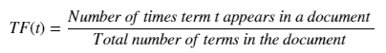
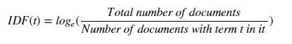
Term Frequency
Counting the occurrences of tokens
Building a sparse matrix of documents x tokens
IDF
Scoring of how rare the word is across documents.

Slide 40
Word Embedding
Vector word representation that allows words with similar meaning to have similar representation
This is one of the important building block for performance of deep learning on NLP
It is capable of capturing context of a word in a document, sematic and syntactic similarity
Word2Vec
One of the most popular technique to learn word embeddings using neural network
Build by Google

Slide 41
Why we need Word2vec
[Have a good day ] [Have a great day]
Result of one hot encoding will be
Have [1,0,0,0,0]
a [0,1,0,0,0]
good [0,0,1,0,0]
great [0,0,0,1,0]
day [0,0,0,0,1]
Here all words are independent of each other.
When we apply Word2vec we setup a dependency between two similar words

Slide 42
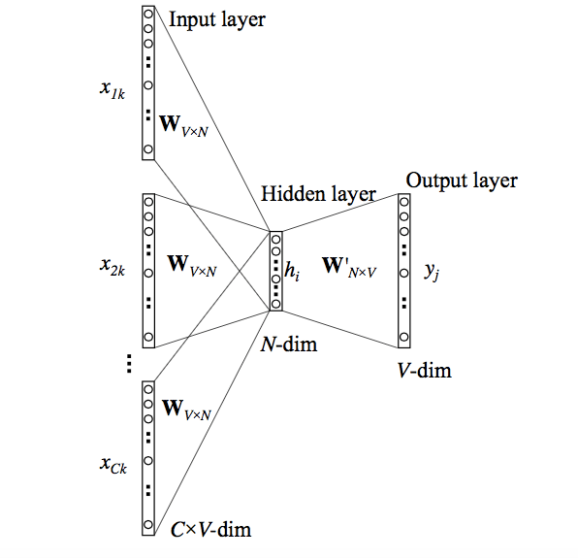
How Word2vec works
Two Approaches
Skip Gram
Common Bag Of Words
CBOW
It takes the context of the word as input
and predict the word corresponding to the context
The input to first layer is one hot encoding of the document
The output layer is a softmax layer which is used to sum the probabilities obtained in the output layer to 1

Slide 43
The CBOW Flow
The input layer and the target, both are one- hot encoded of size [1 X V]. Here V=5
Two sets of weights. one is between the input and the hidden layer and second between hidden and output layer.
No activation function between any layers
The input is multiplied by the input-hidden weights
The hidden input gets multiplied by hidden- output weights
Error between output and target is calculated and propagated back to re-adjust the weights

Slide 44
Skip Gram
Set of sentences called corpus
The method of using current word and predict its neighbour (using context)
The limit on the number of words is called window size
Word Vectors are the weights of the hidden layer of Deep Learning
How Skip Gram works
Input word – Which is the specific word in the middle of a given sentence
Tell the probability for every word in our vocabulary of being the “nearby word” that we chose
For example, if we gave the trained network the input word “Machine”, the output probabilities are going to be much higher for words like “Learning” and “Unsupervised” and “Supervised” than for unrelated words like “Mango” and “Lion”.
We train the neural network to do this by feeding it word pairs found in training documents.

Slide 45
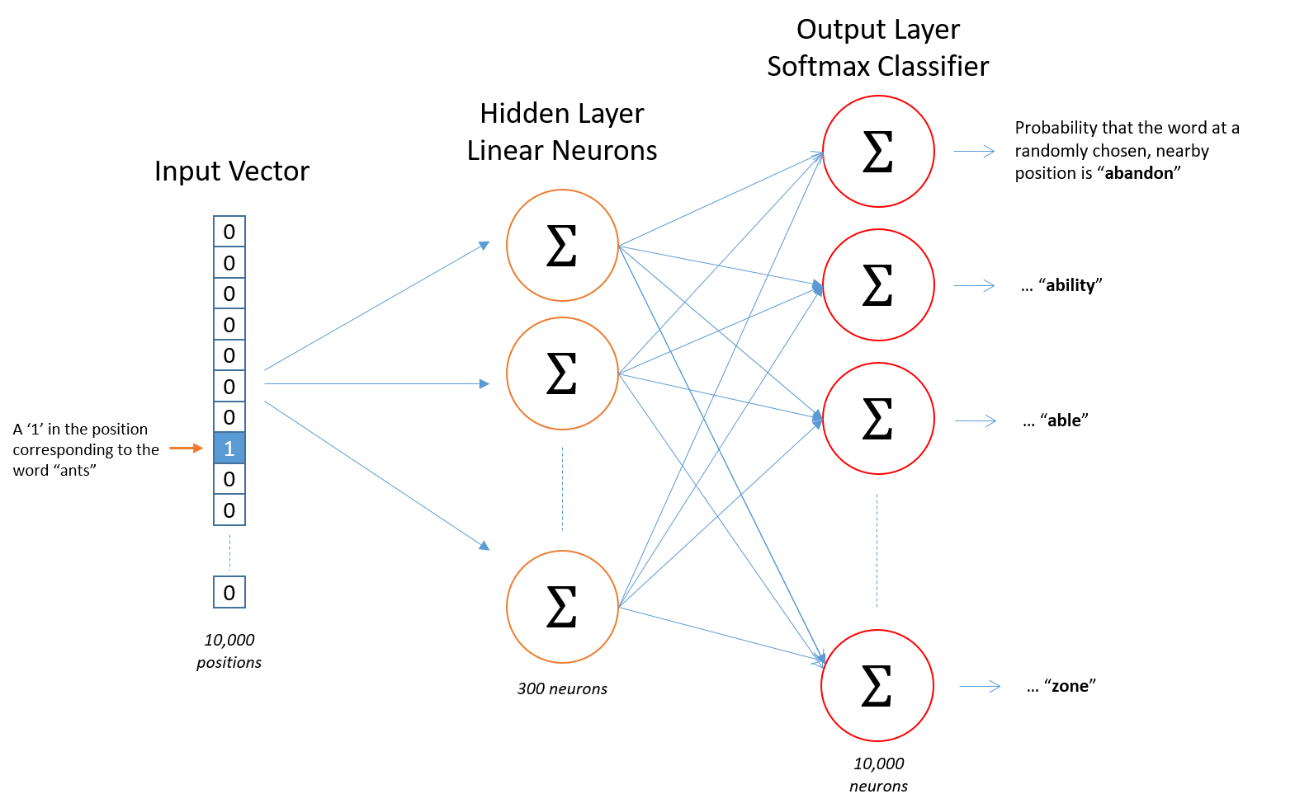
Skip Gram Architecture
No activation function on the hidden layer neurons
The output neurons use softmax.

Slide 46
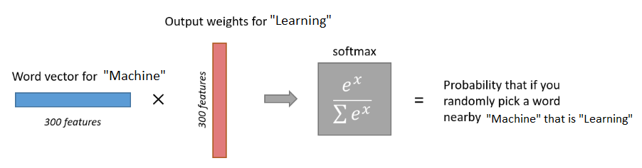
Design Workflow

Slide 47
Seq2Seq Model
Build by Google used for Machine Translation
Uses Deep Learning
It not only takes the current word/input into account while translating but also its neighborhood.
Seq2Seq Working
Input a sequence of words
Generates an output sequence of words
RNN Model is used for predicting sequence
RNN suffers from the problem of vanishing gradient.
LSTM is used in the version proposed by Google.
It develops the context of the word by taking 2 inputs at each point of time. One from the user and other from its previous output, hence the name recurrent (output goes as input).

Slide 48
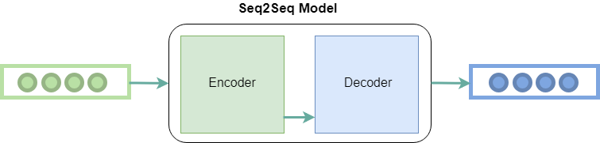
Encoder & Decoder
Encoder: It uses deep neural network layers and converts the input words to corresponding hidden vectors. Each vector represents the current word and the context of the word.
Decoder: It takes as input the hidden vector generated by encoder, its own hidden states and current word to produce the next hidden vector and finally predict the next word.

Slide 49
Machine Learning
Unsupervised and Supervised Learning
Machine learning is an application of artificial intelligence (AI) that provides systems the ability to automatically learn and improve from experience without being explicitly programmed.
Unsupervised learning is a type of machine learning algorithm used to draw inferences from datasets consisting of input data without labelled responses.
Supervised learning is inferring from labelled training data.

Slide 50
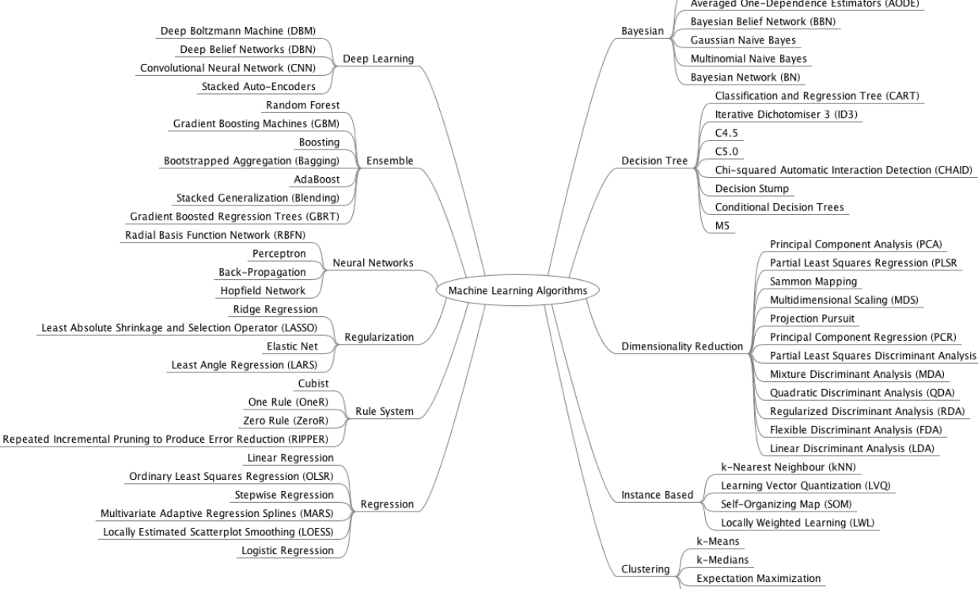

Slide 51
Use Cases of ML
Automotive – Driverless cars
Banking – Opportunity to product new market, balance risk and detect fraud
Government – Enhance security and threat detection
Manufacturing – Product defects, Predictive Maintenance, Operational Efficiencies.
Retail – Continuous monitoring of consumer behaviour, Micro segmentation, product recommendation
Education – Career selection, Online teaching
E-commerce – Recommendation System, Last Mile Delivery, Customer engagement

Slide 52

Challenges with Machine Learning
Data Integration and Preparation
Feature Extraction - Combining the original features (e.g., variables) into a smaller set of more representative features
Feature Selection - Selecting only the most meaningful original features to be used in the modeling algorithm
Feature Engineering - Combining pre-existing features in a data set with one another or with features from external data sources to create new features that can make models more accurate

Slide 53
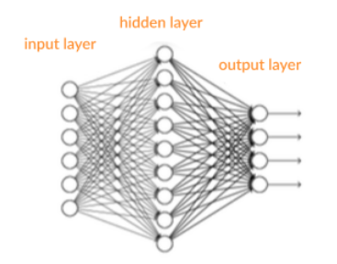
Artificial Neural Networks
It’s a supervised learning system built of neurons or perceptrons
Neurons, connected with each other via interconnected layers, process data to drive information
A shallow neural network has only three layers
An Input Layer
Hidden Layer
Output Layer

Slide 54

Important Terms in ANN
Inputs – Source data from external world and fed into the system
Output – Prediction in terms of real value (probabilities) or Boolean numbers
Neurons/Perceptron – Basic unit of neural network which accept an input data, process it and make prediction
Activation function - Help generate output values within an acceptable range and include the non-linearity component
Weight Space – An optimal set of numeric number which help in measuring the value of an output

Slide 55
Important Terms in ANN Contd…
Forward Pass – Takes the data, passes it through the network and allows each neuron to process the data
Error Function – Defines how far the actual output of the current model is from the correct output.
Backpropagation– Moving data back from the network’s prediction to the neurons that generated that prediction
Bias and Variance - Bias measures how well the model fits the training set. Variance measures how well the model works with unknown inputs that were not available during training
Hyperparameters– A setting that affects the structure or operation of the neural network.

Slide 56
Perceptron
It’s functioning is replica of human brain
Emulate the neurons
Ability to learn and solve complex problems
10
Wo
Constant
Weight Sum
Activation Function
X1
W1
Output
Input
X2
W2
Xn
Wn

Slide 57
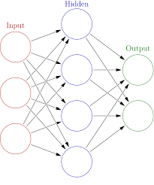
Artificial Neural Network Principle
There are 4 principle object of ANN
There are 3 layers (Input, Hidden and Output)
Input data is called Features and Output data is called Labels
The performance of the learning phase is measure by Loss Function metric
Optimizer is used in improving the learning of ANN

Slide 58

ANN Architecture
Layers
All learning take place inside layers
It is comprised of Neurons (weights)
A Neuron is decomposed into input and activation function
A typical ANN is called fully connected layers
The input data is in form of Vector(Input) and Scalar(Labels)
Activation Function – The function is used to learn the non-linear pattern. It defines the output on the given set of inputs.
The list of most used Activation function is
Rectified Linear Unit (ReLU)
Sigmoid
Tanh
Loss Function – Used to estimate the performance of the optimizer.
For Binary Classification – Cross Entropy
For Linear Regression – Mean Square Error
Optimizer - The optimizer will help improve the weights of the network in order to decrease the loss.
Types of Optimizer are
Stochastic Gradient Descent
Momentum Optimization
AdaGrad
Adam Optimization

Slide 59
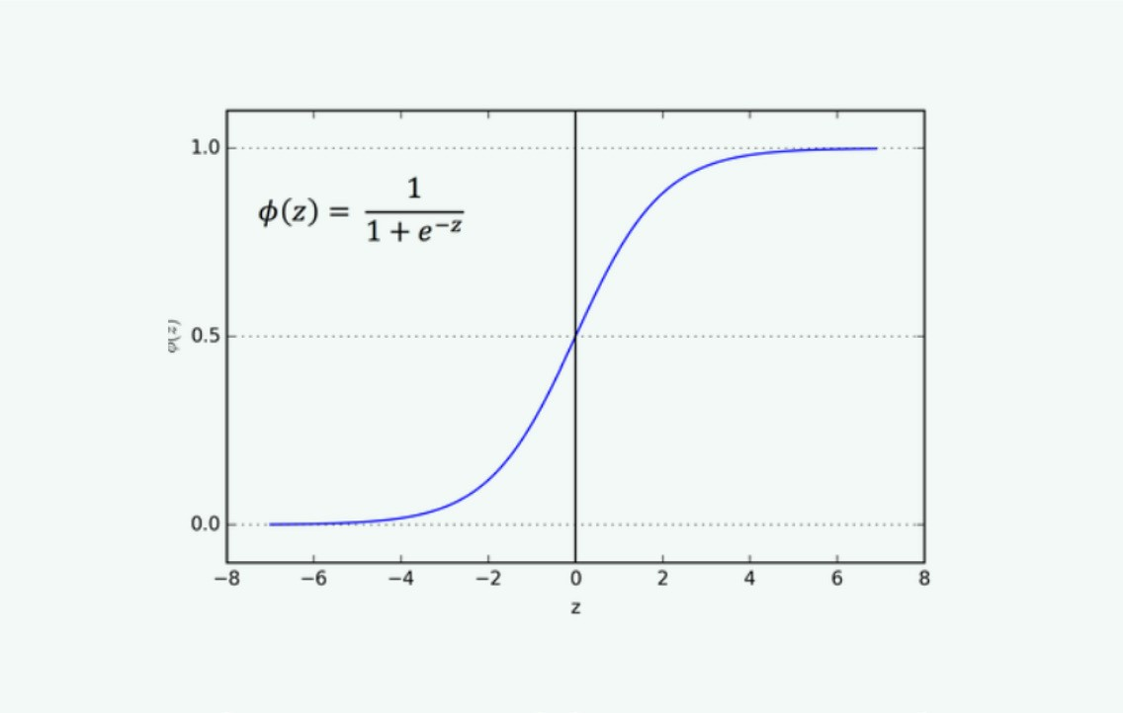

Sigmoid
Also called Logistic Activation function
It gives output between 0 and 1
Is used to predict the probability of an output
The function is diﬀerentiable that means we can ﬁnd slope of the sigmoid curve
Its monotonic but its diﬀerential is not monotonic. This can cause a neural network to get stuck at the training time.

Slide 60
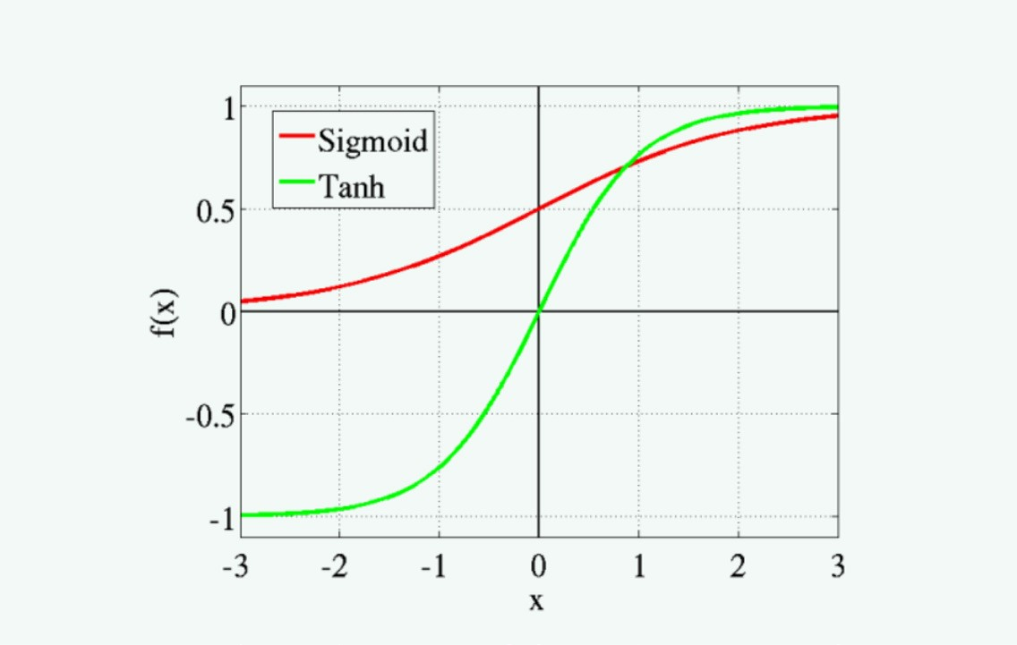

Tanh
Also called Hyperbolic Tangent Activation Function
The range of tanh is -1 to 1 Its also S shaped
The negative inputs will be mapped strongly negative and the zero inputs will be mapped near zero in the tanh graph
The function is diﬀerentiable
The function is monotonic while its derivative is not monotonic

Slide 61
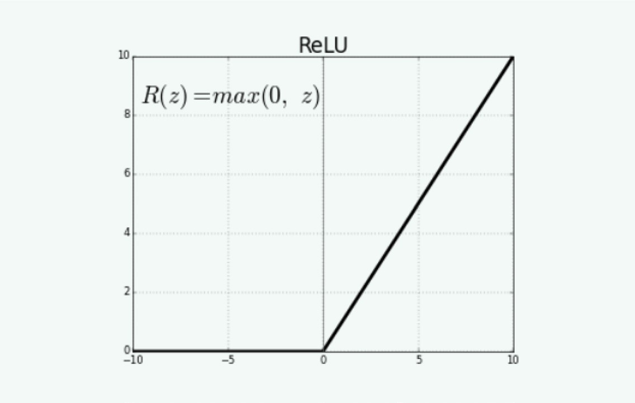

ReLU
Rectiﬁed Linear Unit Activation Function
It’s the most used activation function Range is 0 to inﬁnity
The function and its derivative both are monotonic
Negative input given to the ReLU activation function turns the value into zero immediately in the graph

Slide 62
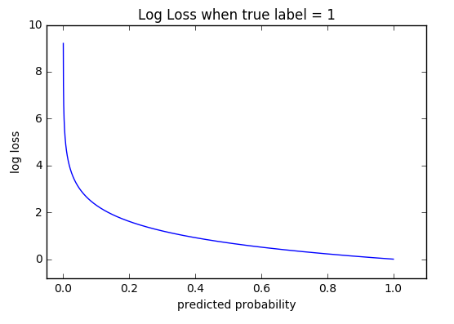
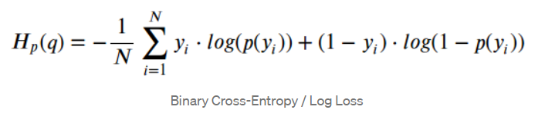
Loss Function – Cross Entropy
Cross-entropy loss, or log loss, measures the performance of a classification model whose output is a probability value between 0 and 1
Cross-entropy loss increases as the predicted probability diverges from the actual label.
Predicting a probability of .012 when the actual observation label is 1 would be bad and result in a high loss value.
A perfect model would have a log loss of 0

Slide 63

Stochastic Gradient Descent
Stochastic Gradient Descent
A gradient is the degree of change of a parameter with the amount of change in another parameter.
It’s a convex function. Looks like the letter “U”
The more the gradient, the steeper the slope.
Gradient Descent is an iterative method which is used to find the values of the parameters of a function that minimizes the cost function as much as possible.
There are three types of Gradient Descent
Batch Gradient Descent
Stochastic Gradient Descent
Mini-batch Gradient Descent
Stochastic - A system or a process that is linked with a random probability.
Few samples are selected randomly instead of the whole data set for each iteration.

Slide 64

Limitation of ANN
Overfitting
Can’t generalised new data
Generate biased prediction
Ways to Overcome Overfitting
Weight Regularization - Add constraints to the weights of the network
L1: Lasso: Cost is proportional to the absolute value of the weight coefficients
L2: Ridge: Cost is proportional to the square of the value of the weight coefficients
Network Size - Start with a small amount of layer and increases its size until we find the model overfit
Dropout - Some weights will be randomly set to zero using dropout rate

Slide 65
TensorFlow

Slide 66
TensorFlow Introduction
Developed By Google Brain Team
To accelerate Machine Learning and Deep Neural Network research
Opensource Framework
Can run on multiple CPU, GPU and Mobile devices
Wrappers are written in Java, C++ and Python
Tensors = multi dimensional array
Flow = Flowchart of operations called graphs
Very fast at computing the matrix multiplication because it is written in C++

Slide 67
Popular Use Cases
Gmail
Google Photos
Google Search Engine
Speech recognition
Image recognition
Object tagging videos
Self-driving cars
Sentiment analysis
Detection of flaws
Text summarization
Mobile image and video processing
Air, land, and sea drones

Slide 68
List of Companies got benefit from TensorFlow
Airbnb – Improve the guest experience by classifying images and detect object at scale
Airbus –Monitor changes on earth surface for urban planning, mapping landscapes and damages due to catastrophes
Carousell – Improve buyer and Seller experience by building ML models with images and NLP
GE Healthcare – Identify anatomy on MRIs of the brain
PayPal - Fraud Detection using TensorFlow
Twitter – Ranking Tweets
Kakao – Predict the probability of trip completed rate when dispatch driver to fulfil ride hailing requests
CocaCola – Proof- of Purchase capability
China Mobile – Detect network anomalies and verify operations logs

Slide 69
Tensor - A tensor is a vector or matrix of n-dimensions that represents all types of data.
Node - The node carries the mathematical operation and produces an endpoints outputs.
Edges - The edges explain the input/output relationships between nodes.
Shape - Its a dimensionality of the matrix or array
Graph – All operations are conducted successively in graph
TensorBoard - It is used to visualize TensorFlow graph, plot quantitative metrics about the execution of graph, and show additional data like images that pass through it.
TensorFlow Components
Var 1
Addition
Var 2

Slide 70
Tensors
Every Tensors has three main properties
Unique Label (name)
Dimension (shape)
Data Type (dtype)
Four types of Tensors
tf.Variable
tf.constant
tf.placeholder
tf.SparseTensor

Slide 71
TensorFlow Mathematical Operations
Following is a list of commonly used operations.
tf.add(x, y)
tf.substract(x,y)
tf.multiply(x,y)
tf.div(x,y)
tf.pow(x,y)
tf.exp(x)
tf.sqrt(y)
tensor_x = tf.constant([[5,9]], dtype = tf.int32)
tensor_y = tf.constant([[30, 14]], dtype = tf.int32)
tensor_add = tf.add(tensor_x, tensor_y)
print(tensor_add)
Tensor("Add:0", shape=(1, 2), dtype=int32)
tensor_multiply = tf.multiply(tensor_x, tensor_y)
Tensor("Mul:0", shape=(1, 2), dtype=int32)
Important : The tensors should have same shape

Slide 72
TensorFlow Variables
Variables represent the nodes where values change.
tf.get_variable(name = "", values, dtype, initializer)
argument
- name = "": Name of the variable
- values: Dimension of the tensor
- dtype: Type of data. Optional
- initializer: How to initialize the tensor. Optional
If initializer is specified, there is no need to include the `values` as the shape of `initializer` is used.
var1 = tf.get_variable("var", [1, 2])
print(var1.shape)
(1, 2)
var_1 = tf.get_variable("var_1", [1, 2], dtype=tf.int32, initializer=tf.zeros_initializer)
print(var_1.shape)

Slide 73
TensorFlow Placeholder
Placeholder are used to feed the tensor
Feed_dict is used to pass value to placeholder
Placeholder are feed in sessions only
tf.placeholder(dtype,shape=None,name=None )
arguments:
- `dtype`: Type of data
- `shape`: dimension of the placeholder. Optional. By default, shape of the data
`name`: Name of the placeholder. Optional
placeholder_x = tf.placeholder(tf.float32, name = "data_placeholder_a")
print(placeholder_x )
Tensor("data_placeholder_a_5:0", dtype=float32)

Slide 74
Session
Execute the operations
Operators are run inside the session
Session can run independently or within block
#Independent
sess = tf.Session()
result = sess.run(addition)
print(result)
sess.close()
#Block Auto close Session
with tf.Session() as sess:
result = multiply.eval()
print(result_2)

Slide 75

List of Algorithms Supported
Linear regression: tf.estimator.LinearRegressor
Classification:tf.estimator.LinearClassifier
Deep learning classification: tf.estimator.DNNClassifier
Deep learning wipe and deep: tf.estimator.DNNLinearCombinedClassifier
Booster tree regression: tf.estimator.BoostedTreesRegressor
Boosted tree classification: tf.estimator.BoostedTreesClassifier

Slide 76
TensorFlow Implementation
Load Data in Memory - Load all data into memory as a single array.
Load Data in Pipeline - TensorFlow has built-in API that helps to load the data, perform the operation and feed the machine learning algorithm easily.

Slide 77
Keras

Slide 78

Keras Overview
Runs on top of open source libraries such as Tensorflow, Theano or CNTK etc
With minimal structure we can create powerful deep learning model using Keras
Keras contains list of modules that have pre-defined classes, function, variables used in deep learning

Slide 79
List of available Modules
Initializers
Regularizers
Constraints
Activations
Losses
Metrics
Optimisers
Callback
Text Processing
Image Processing
Sequence Processing
Backend
Utilities

Slide 80
Deep Learning
A special branch of Machine learning where features are automatically extracted by the algorithm.

Slide 81
Applications
Image Classification
Semantic Parsing and Question Answering
Paraphrase Detection
Language Generation and Multi-document Summarization
Machine Translation
Speech Recognition
Character Recognition
Spell Checking
Text Classification and Categorization
Conversation Bot

Slide 82
List of Companies Got benefitted with Deep Learning
SALESFORCE – San Francisco, California
Created a platform called Einstein to simplify artificial intelligence and improve customer experiences with smarter and more personalized service.
H20.AI – Mountain View, California
Created the H2O Driverless AI platform that facilitates the delivery of expert data science.
DESCARTES LABS - Santa Fe, New Mexico
Data-refinery on a cloud-based supercomputer for the applications such as disease control, disaster mitigation, food security and satellite imagery.
TWOSENSE.AI – New York
A mobile SaaS security product applies machine (and deep) learning to eliminate authentication challenges and prevent fraudulent activity in biometric

Slide 83
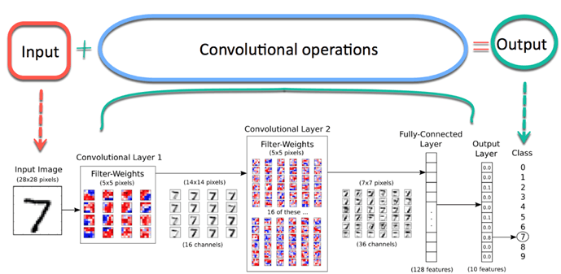
Convolutional Neural Network (CNN)
A well-known method in Computer Vision
Best for Image Processing such as detecting object from images/Video
Image- An array of Pixels with height and width

Slide 84
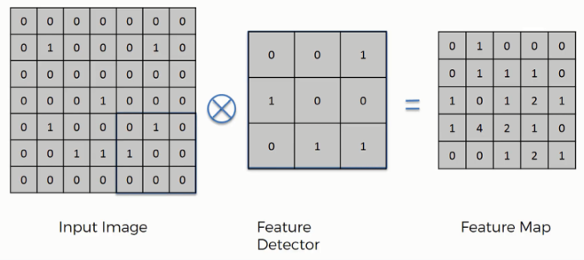
Components of CNN
There are four components of CNN
Convolution –
Extract features from the object on the image locally.
Learn specific patterns with in the pictures
Computer scan a part of the image (3x3 matrix)
Multiples the scanned part with filter and build feature map
Repeat the multiplication for complete image scan

Slide 85
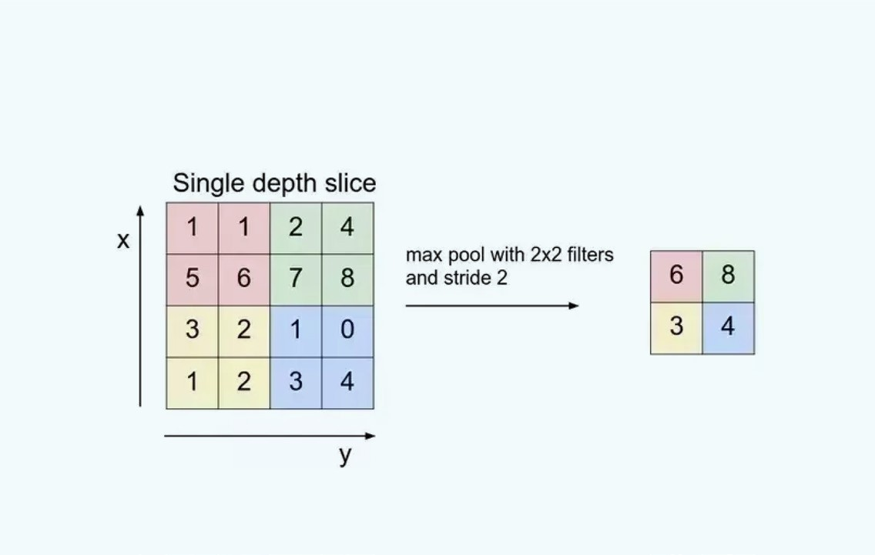
Components of CNN contd…
Activation Function
Add non-linearity component
Mostly ReLU is used as activation function
All –ev values replaced with 0
Max-Pooling
Reduce dimensionality of input image
Reduce the computational complexity of the operation
Prevent Overfitting
Returns maximum value from sub-matrix
Fully Connected Layer
. Build ANN
. Apply Sigmoid activation function
. Classify the image

Slide 86
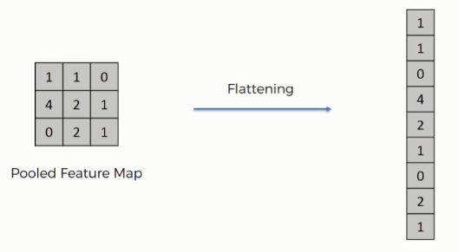
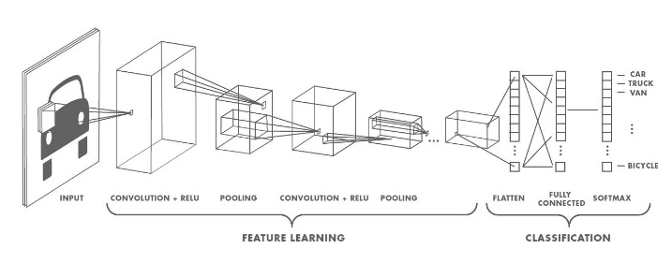
Activation Function
Add non-linearity component
A value is passed through a function that squashes the value into a range
Mostly ReLU is used as activation function
All –ev values replaced with 0
Flatten Layer
Fully Connected Layer
. Build ANN
. Apply Sigmoid activation
function
. Classify the image

Slide 87
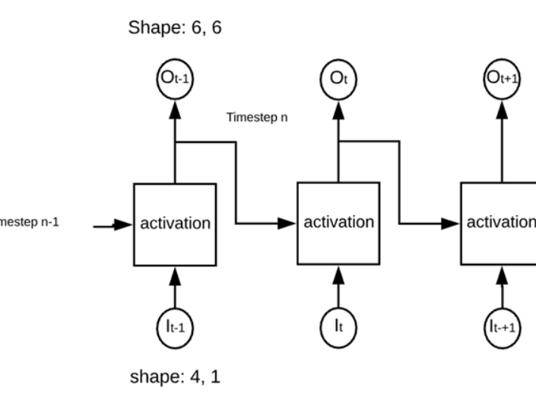
RNN (Feedback)
Similar to traditional ANN with an added Memory State to the neurons.
It is able to ‘memorize’ parts of the inputs and use them to make accurate predictions.
Deal with sequential data to make predictions.
TimeStep - Output is sent back to itself number of time
The network is called 'recurrent' because it performs the same operation
The network computed the weights of the inputs and the previous output before to use an activation function.

Slide 88

How RNN Works ?
Input an example from a dataset.
The network will take that example and apply some complex computations to it using randomly initialised variables (called weights and biases).
A predicted result will be produced.
Comparing that result to the expected value will give us an error.
Propagating the error back through the same path will adjust the variables.
Steps 1–5 are repeated until we are confident to say that our variables are well-defined.
A predication is made by applying these variables to a new unseen input.

Slide 89
Application of RNN
Predicting stock prices
Anticipating the trajectory of the vehicle
Machine Translation
Sentiment Analysis
Chat Bots

Slide 90
Limitation of RNN
Less efficient when timestep is large
Untrainable when many deep layers
Vanishing Gradient Problem - The gradients grow smaller when the network progress down to lower layers. So no change in gradient and Neural Network stops learning
This means that the network experiences difficulty in memorizing words from far away in the sequence and makes predictions based on only the most recent ones
Solution – LSTM

Slide 91
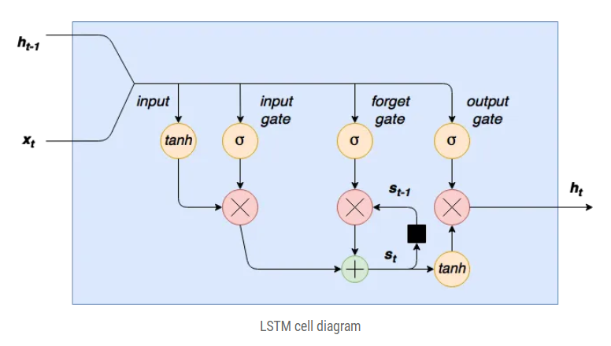

Long-Short Term Memory (LSTM)
Extension to RNN
LSTM’s enable RNN’s to remember their inputs over a long period of time
LSTM can read, write and delete information from its memory.
It learns over time which information is important and which not.
LSTM keeps the gradients steep and therefore the training relatively short and the accuracy high.
Ref : https://colah.github.io/posts/2015-08-Understanding-LSTMs/

Slide 92
How LSTM Works ?
Squashed via tanh
Sigmoid to Kill Off
Remember/Forget
Cell State - It runs straight down the entire chain, with only some minor linear interactions.
The LSTM does have the ability to remove or add information to the cell state, carefully regulated by structures called gates.
Gates are a way to optionally let information through. They are composed out of a sigmoid neural net layer and a pointwise multiplication operation.
Control Output
Reduce the risk of Vanishing Gradient

Slide 93
Thank You

